Slide 1
Seniors MENTAL Health Strategy for Winkler-Morden Area
Build Trust to Face MENTAL Health Crisis’ Together
Preliminary Proposal Outline
Julie McNeice & Lisa Peters-Arora

Slide 2
WHO IS INVOLVED?
Winkler-Morden Area
Participants are:
-Seniors
-Mental Health Managers
-Service Providers and Volunteers
Shared Purpose Statement:
To develop shared values and perspectives in order to find a mutual decision-making process

Slide 3

METHODS OF APPLIED SOCIAL SCIENCE RESEARCH
Participant Questionnaire For instance:
Age
gender
Cultural background
Top three values: personal, family, “community-of-interest”
Future Search Method
3-Day Principal-based planning meeting helps people transform capability for action quickly, is task focused
Brings people from all walks of life into same conversation
The meeting design comes from theories and principles tested in many cultures for the past 50 years.
It relies on mutual learning among stakeholders as a catalyst for voluntary action and follow-up. People devise new forms of cooperation that continue for months or years.
Values & Our Health Voting Simulation:
Day 1: Personal “Past” based values view
Day 2: Family “Present” based values view
Day 3: Healthcare “Community of Interest” “Future” based values view

Slide 4
SIXTY PARTICIPANTS DEMOGRAPHICALLY REPRESENTED
“Seniors & Caregivers” seniors, caregivers, those vulnerable, parents
Mental Health Providers
In “paid-for” services including civil, local and provincial government
“Free” Mental Healthcare Resources
Volunteers and “Helpers”
(i.e. non-profit and not-for-profit organizations who support seniors)
Youth demographically represented sprinkled throughout participant groups

Slide 5
EXAMPLE QUESTIONNAIRE
-Age Range: 15-24____ (high school?) (young adult?)
Adult (25-64) _____
Senior 55-65 ____ 65-70 ___ 70+ ___
-Sex/Gender
-Identifying Cultural Background ________________________
-Top three most important values in order of importance (i.e. honesty, integrity, etc.)
Personal Values: 1. __________ 2. __________ 3. ___________
Family Values: 1. __________ 2. __________ 3. ___________
Healthy Community Values: 1. __________ 2. __________ 3. ___________
Check off box:
Senior ____
Primary Caregiver ____
“other” type caregiver (explain: _________________)
I am a vulnerable person health-wise ____
Parent of vulnerable person ____
Volunteer in healthcare (describe volunteer activity: ___________________)
Not-for profit sector (describe sector: ________________________)
Healthcare provider title ______________________________
  In: __ Civil __ Local __Provincial ___ Federal government _______
Notes:
https://www.statcan.gc.ca/eng/concepts/definitions/age2

Slide 6

THREE-DAY CONFERENCE
Day 1: The Past
What values from your past have shaped you?
Day 2: The Present
What values do you presently hold that make you who you are today?
Day 3: The Future
What values are you forming as a vision for your future that you can use to implement a good working path forward?

Slide 7
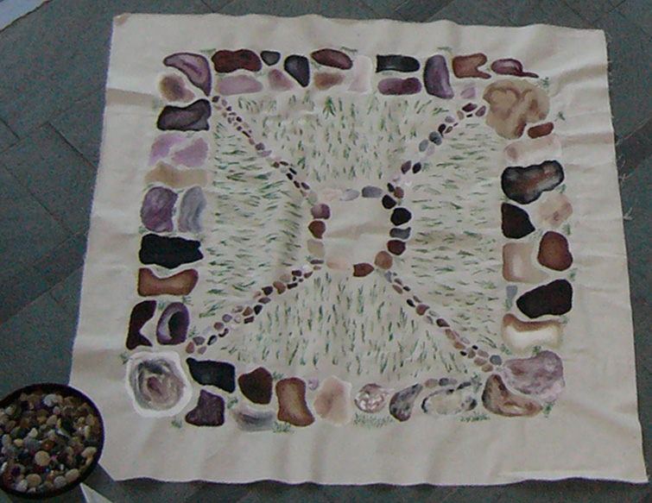
VALUES VOTING CIRCLE
ACHIEVEMENT & ESTEEM
Personal fulfillment
Respect
Self-actualization
Worth
HEALTH & WELLNESS
“we see things clearly”
Health
Freedoms
Illumination
Fun
Individualism
Authenticity
Creativity
Responsibility
SAFETY & SECURITY
Introspection “looks within”
“feels safe”
Safety, personal, family, “community-of-interest”
Security, personal & cultural
Meeting of Values Place
Three-Day Conference
Day 1: Past
Day 2: Present
Day 3: Future
LOVE & BELONGING
“the nature of our heart”
Social Identity
Cultural Identity
Family Circles
Unconditional Acceptance

Slide 8
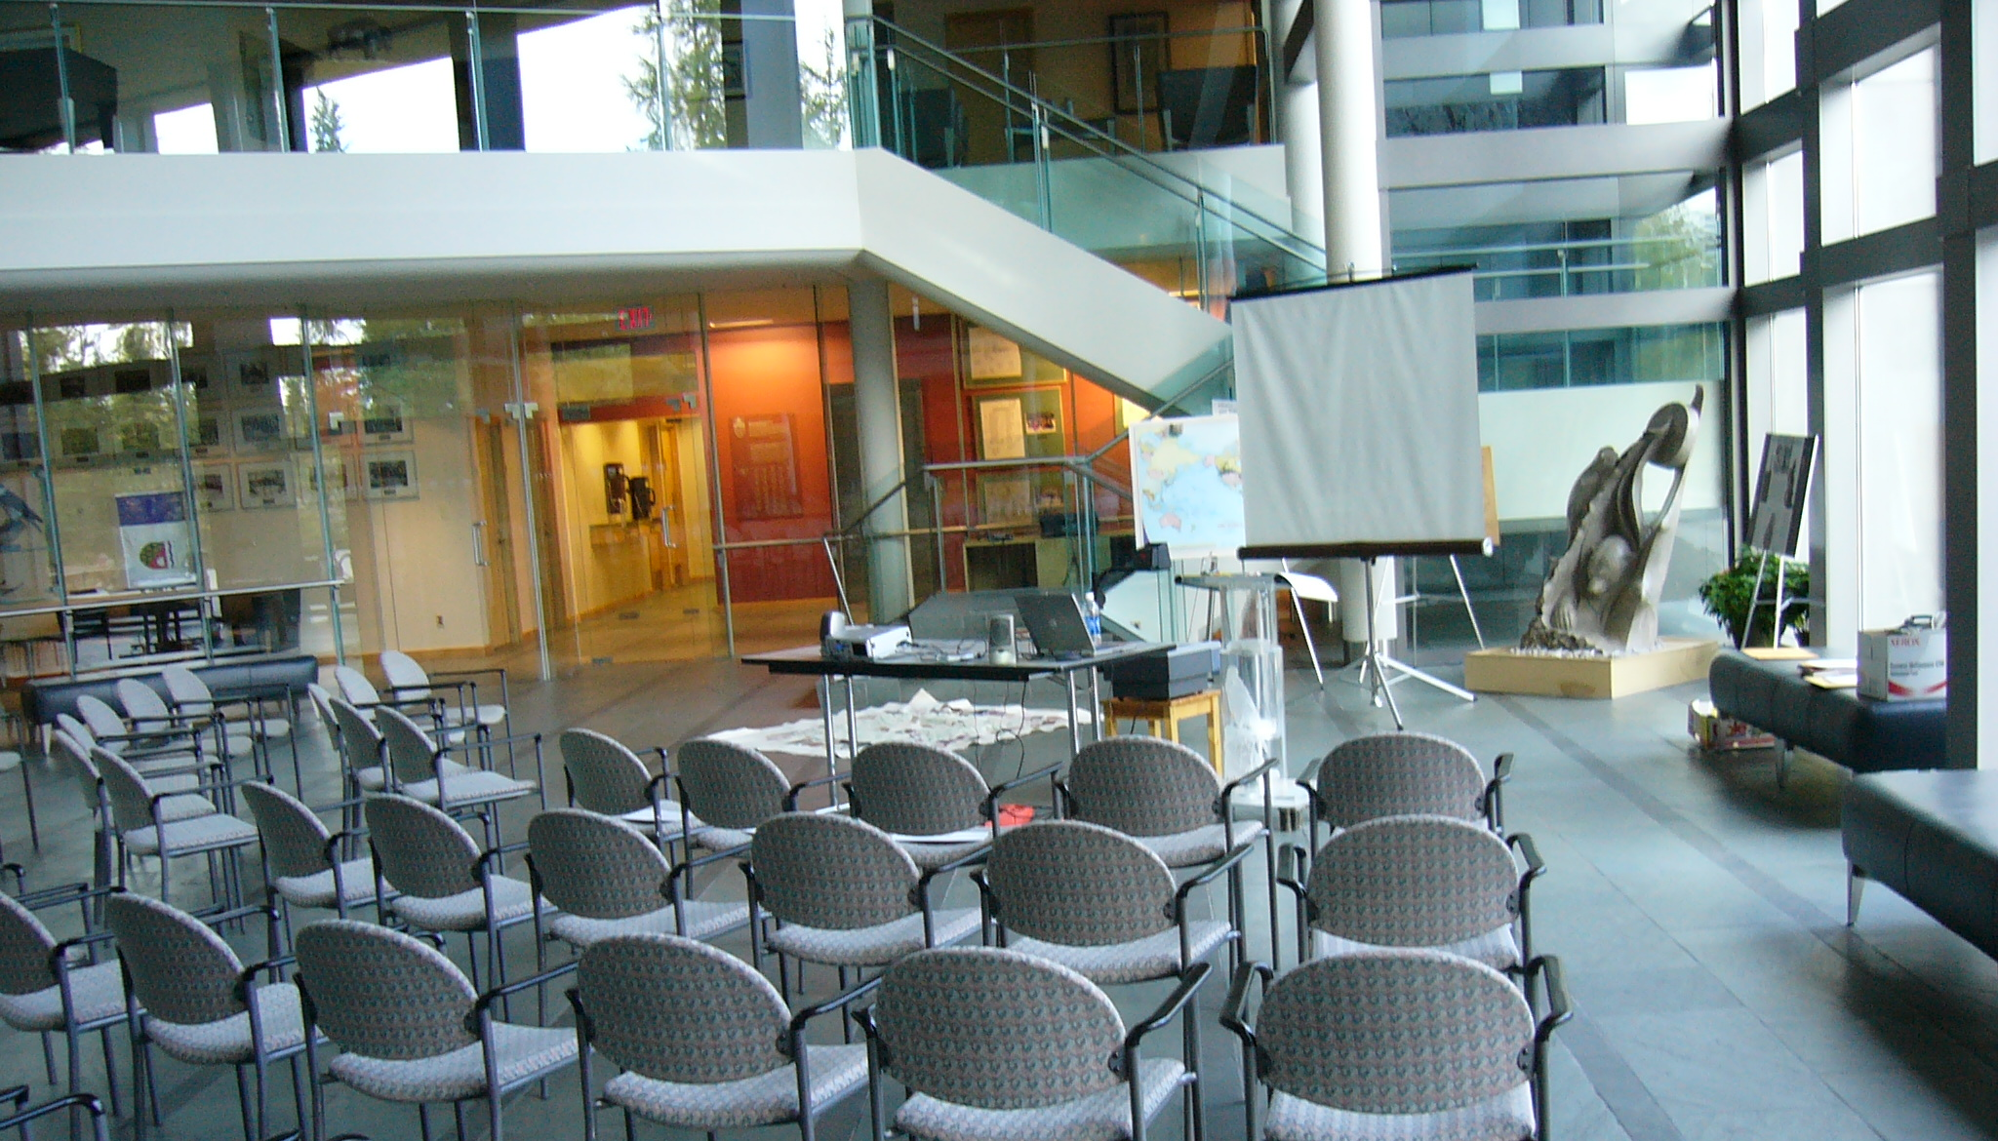
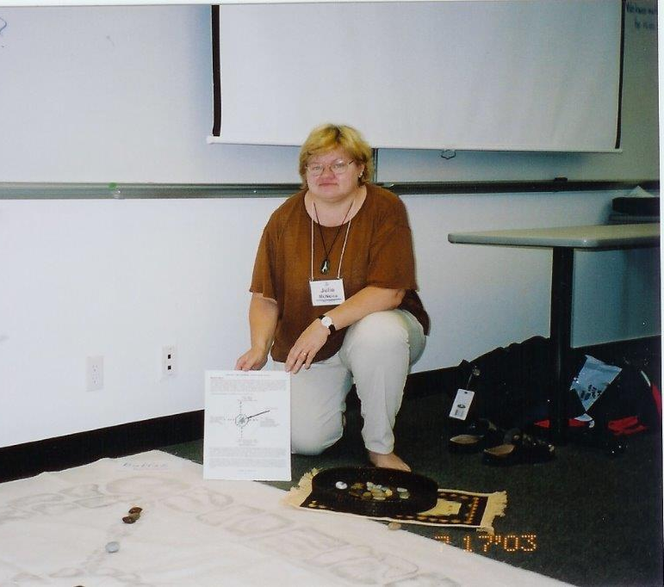
VALUES VOTING SEMINAR

Slide 9
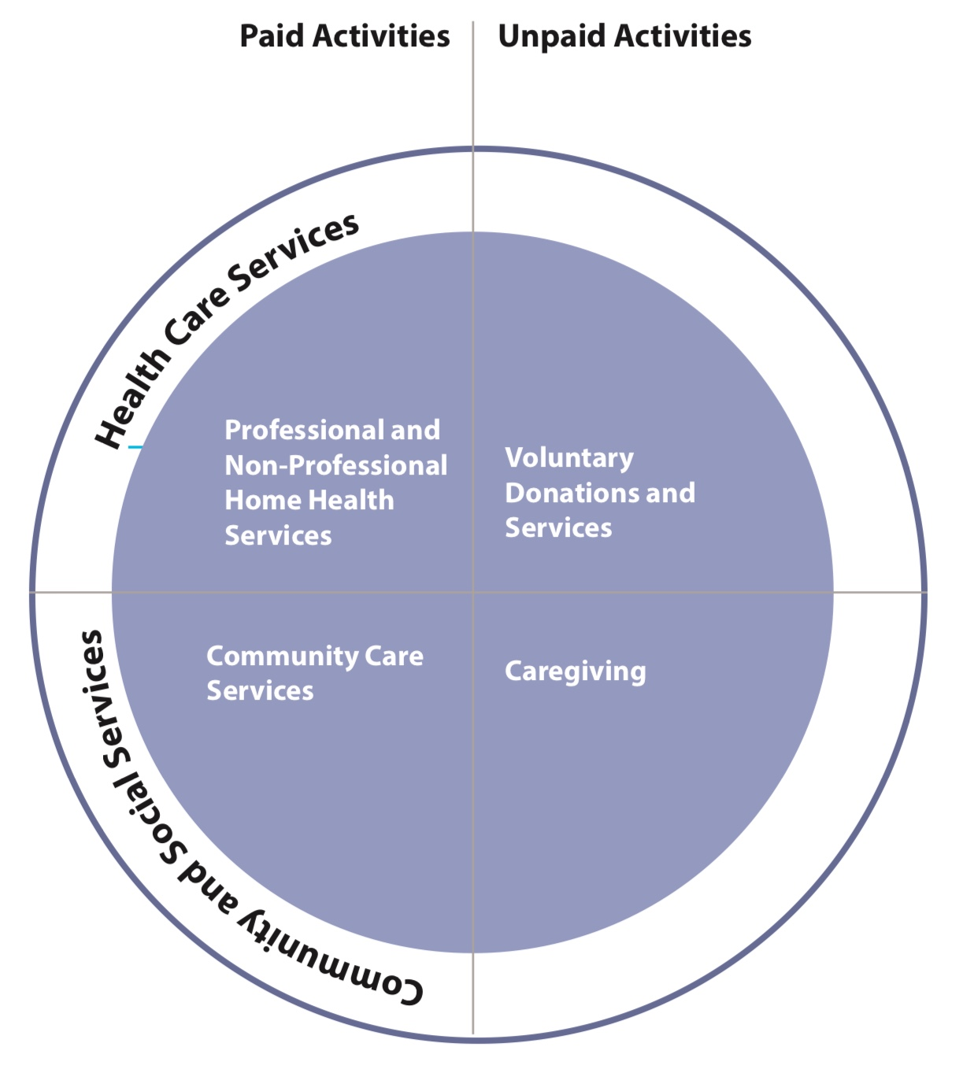
AFFIRMATION ONE
“Conceptual Framework for Home and Community Care in Canada”
National Seniors Strategy report 2016
Found at: http://nationalseniorsstrategy.ca/wp-content/uploads/2016/10/National-Seniors-Strategy-Second-Edition.pdf
Accessed 18/06/2020

Slide 10
Dr. Jordan Peterson
AFFIRMATION TWO
Get to Know Yourself and Seek Self Improvement
“When you construct the narrative of your life, you can find out what to strive for and what to stay away from.
…articulate your rationale so that you can quell your doubts and move forward:
The Past Authoring - Learn what happened to you in the past that made you who you are now.
The Present Authoring - Identify your faults so you can improve them and your virtues so that you can continue to capitalize on them.
The Future Authoring - Formulate a vision for your life and develop an implementable plan.
By knowing yourself, your anxiety will push you forward instead of stopping you. Find the reasons to keep you on track.

Slide 11
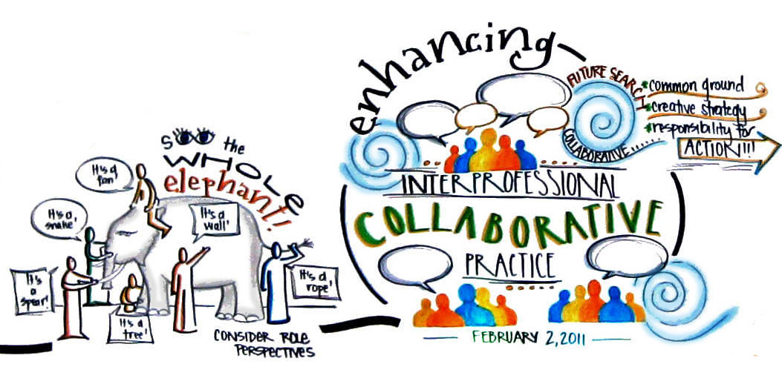
FUTURE SEARCH METHOD
Principle-based action planning that helps people transform their capability into action quickly.
https://futuresearch.net

Slide 12
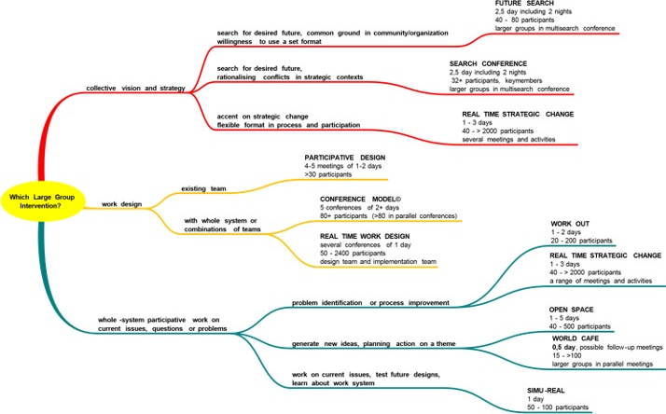
VISUAL MEETING FACILITATION

Slide 13
FUTURE SEARCH PROCESS
REFLECTING ON THE PAST
EXPLORING THE PRESENT
PLANNING FOR THE FUTURE
Timeline activity – Participants re-tell the story of what’s happened in individual, national and global realms
What wisdom can we take forward?
Stakeholder groups describe their “land” What realities do we share and how are we inter-dependent?
Context mapping of political, social, economic, technological, and environmental trends
What trends concern us most?
Stakeholder group mind mapping of top priority concern
What are we already doing about it? What would we like to be doing about it?
What are we proud of? What are we sorry for?
Mixed stakeholder groups imagine and present the ideal future
Where is the common ground? Potential projects? Areas of non-agreement?
Self-selecting groups develop high-level action plans
What will we do?

Slide 14
FUNDING OPPORTUNITIES

Slide 15
CIRA – Canadian Internet Registration Authority
The CIRA vision and mission
Our vision is to be a world-class internet registry that is recognized and valued by the internet community and Canadians. To do so, we foster the development of .CA as a key public resource for all Canadians by providing stable, secure and trusted domain name services, and by taking a leadership role in shaping Canada’s internet for the benefit of .CA domain holders.
https://www.cira.ca/improving-canadas-internet

Slide 16
EXPAND VIRTUAL HEALTH SERVICES
Oncology
SCCR
Palliative Care
Medication
Volunteer
Family Member
Nurse Navigation
Caregiver
Patient
Katie Cares
Physio

Slide 17
FUNDING OPPORTUNITIES…
NEW HORIZONS FOR SENIORS
WELLNESS TOGETHER CANADA
SENIORS CAN CONNECT
COMMUNITY BASED PRIMARY HEALTH CARE
CANADIAN INSTITUTES OF HEALTH RESEARCH
HEALTHY AGING IN CANADA
AGE FRIENDLY MANITOBA INITIATIVE
QUALITY END-OF-LIFE CARE COALITION OF CANADA
CANADIAN HOSPICE PALLIATIVE CARE ASSOCIATION
UNITED WAY
FEDERAL EMPLOYMENT AND SOCIAL DEVELOPMENT

Slide 18
THREE-DAY CONFERENCE NEEDS
Printing Questionnaires
Mail outs
Hotel conference room
Catering services
Facilitation Fees
Printing
Values voting stones

Slide 19
…copies of news releases have many more references using phrases like:
Vulnerable Canadians
Mental health supports
Reliable health information in safe and secure manners to reduce pressure on our health system
Help governments, public health officials, hospitals and health care facilities make evidenced-based decisions (240.5 million May 3rd ) refers to Wellness Together Canada
Expand virtual health services
Virtual care and mental health tools

Slide 20
…copies of news releases have many more references using phrases like continued…
Promoting volunteerism
Mentoring
Elder abuse awareness
Social participation
Capital assistance
Invest to provide Canadian seniors with freedom and peace of mind
Increase awareness, reduce stigma, develop treatment guidelines and best practices for early diagnosis and help us better understand dementia and its effects on our communities.
Medical cannabis as an alternative to opioid pain medication

